Slide 1
AI Airlift - Designing Intelligent Apps and Agents
Rodrigo Souza
Applied Data Scientist
LearnAI Team / Cloud & AI
Vinod Kurpad
Principal Program Manager
Applied AI / Cloud & AI

Slide 2
Wi-Fi
SSID: Data&AI
Password: Micr0soft19

Slide 3
LearnAI Team – learnai@microsoft.com http://aka.ms/LearnAI-Portal http://aka.ms/LearnAI-GitHub http://aka.ms/LearnAI-Links This Training http://aka.ms/LearnAI-Airlift

Slide 4
This Training http://aka.ms/LearnAI-Airlift LearnAI Airlift = CSB + KMB
50% 50%
Original 2 Days 2 Days
Airlift version 1.5 D 1.5 D

Slide 5
Training Goals – What Will You Learn
CSB
Computer Vision
Custom Vision
LUIS
Bot
Bing Search
KMB
Azure Search / Cognitive Search
Azure Functions
Content Moderator
Bot
Poll

Slide 6
Training Goals – How Will You Learn
Presentations
Hands-On Labs to Build E2E Applications
CSB = Intelligent Search
KMB = Cognitive Search

Slide 7
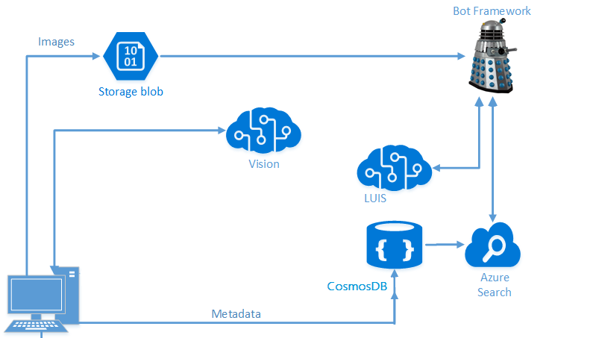
Architecture – Intelligent Search

Slide 8
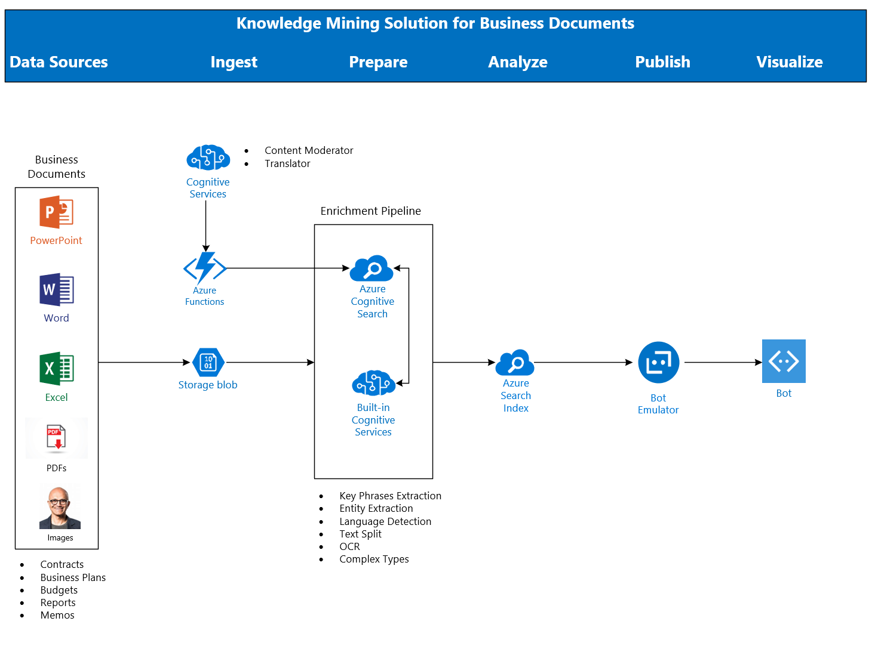
Architecture - Cognitive Search

Slide 9
Housekeeping
Breaks
Lunch
Restrooms
Audience
Partners
Microsoft
Office Hours
Survey

Slide 10
Spektra Environment
Azure Account
DSVM
Deployed Services: storage account, CosmosDB, Computer Vision API
Azure Search should be created in the same region of the DSVM

Slide 11
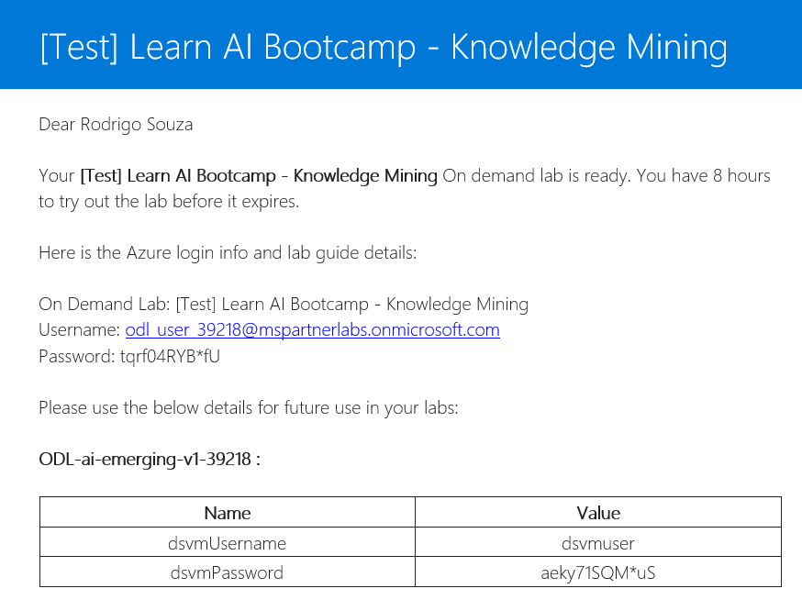
Spektra Environment
http://aka.ms/LearnAI-spektra-cs
Confirmation email from noreply@cloudlabs.ai

Slide 12
Breaking News
Container support in Azure Cognitive Services
https://docs.microsoft.com/en-us/azure/cognitive-services/cognitive-services-container-support
Power BI delivers AI power
https://www.zdnet.com/article/power-bi-delivers-ai-power/

Slide 13
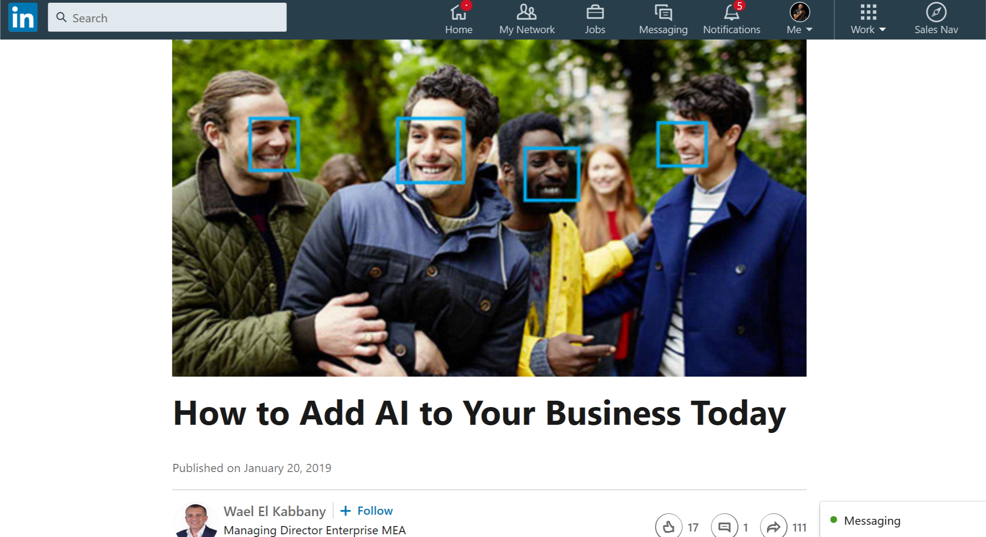
More News
https://www.linkedin.com/pulse/how-add-ai-your-business-today-wael-el-kabbany/

Slide 14
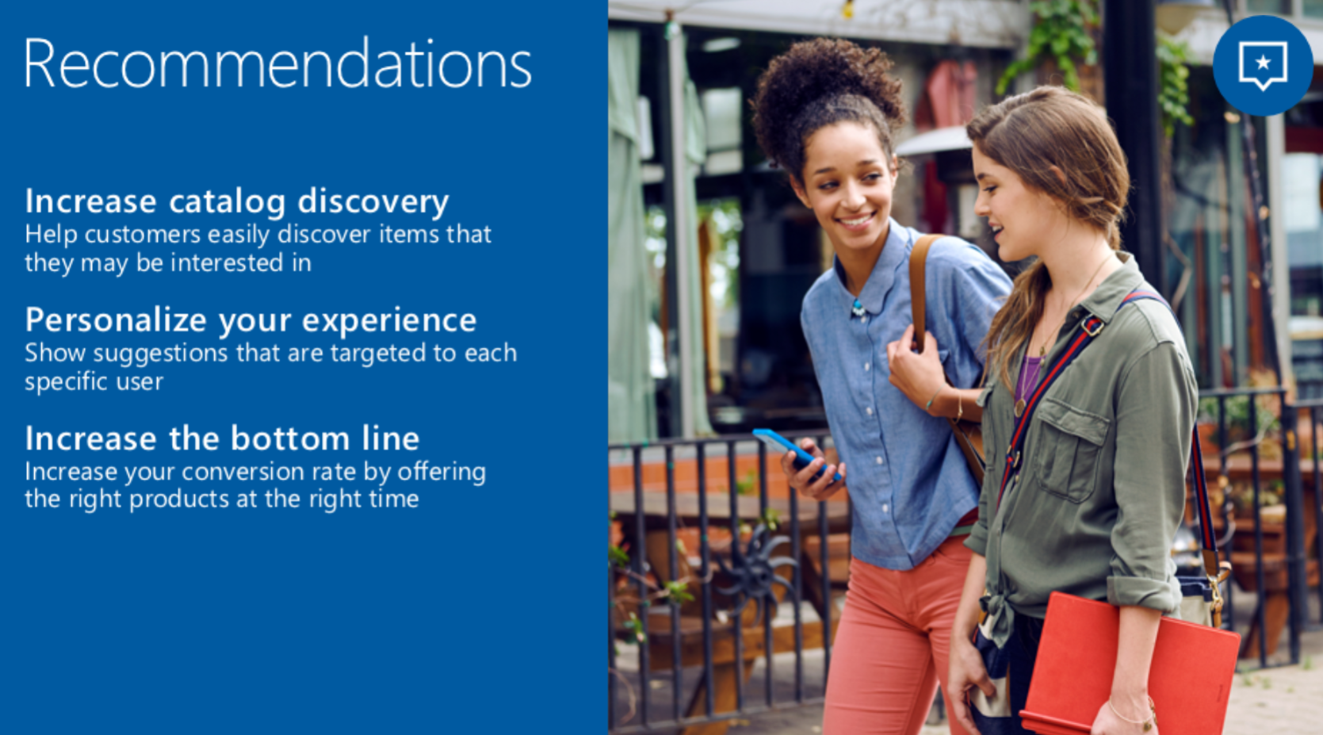
Breaking News

Slide 15
Breaking News
Going to Private Preview – Invitation Only
Personalization and Optimization
Based on Reinforcement Learning
Learns from the real world based on feedback
Don’t need to label the data
Don’t need to train your model
AI suggests and you give a feedback, over and over
Used in Xbox, Bing, Office, Azure, Windows, Skype.
Now available to any developer.

Slide 16
Let’s go! http://aka.ms/LearnAI-Airlift

Slide 17
Thank you! LearnAI Team – learnai@microsoft.com http://aka.ms/LearnAI-Portal http://aka.ms/LearnAI-GitHub http://aka.ms/LearnAI-Links

Slide 18
Backup Slides

Slide 19
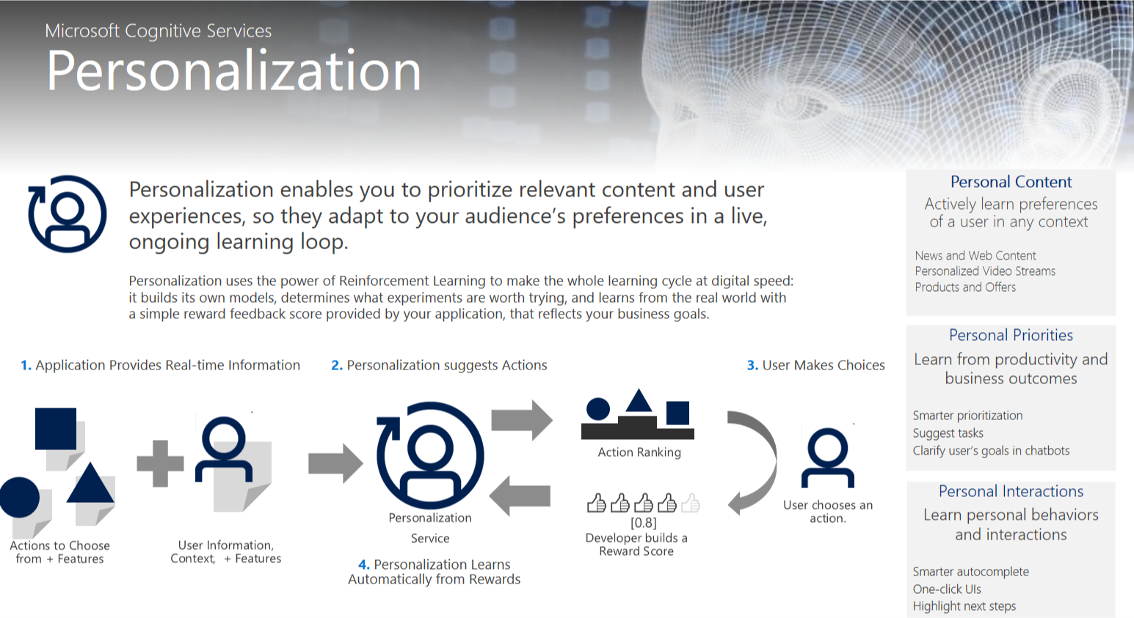
Breaking News

Slide 20
Good Morning!!!
http://aka.ms/LearnAI-Airlift-Survey
http://aka.ms/LearnAI-kmb

Slide 21
Links
http://aka.ms/LearnAI-Links
Suggestions, Feedback, Redeliveries
learnai@microsoft.com
rosouz@microsoft.com
Thank you!!

Slide 22
Survey!!
http://aka.ms/LearnAI-Airlift-Survey
Suggestions, Feedback, Redeliveries
learnai@microsoft.com
rosouz@microsoft.com
Thank you!!

Slide 23
Opening Demos
www.azure.com/cognitive
Curl

Slide 24
Custom Vision URLs
https://docs.microsoft.com/en-gb/azure/cognitive-services/custom-vision-service/getting-started-build-a-classifier
http://customvision.ai

